Slide 1

Business Case: Predictive Analytics & Dashboarding for ATD Optimization
Sergio Xavier Chávez Villa

Slide 2

Objective: Better Understanding of deliverys
At Uber Eats, delivering food at the right time isn’t just about logistics — it’s about trust.
ATD (Actual Time of Delivery) = The total time, in minutes, it takes from when the order is rest offered until it is delivered to the final destination
Strong relationship between delivery time and customer satisfaction level
Understanding and improving delivery accuracy is a constant challenge and a major opportunity.

Slide 3

Objective: WorkFlow The objective is to automate the extraction of dispatch metrics data from the last week for Mexico and store it in a table within the AA_tables schema, updating it every week.
Weekly information: With the Scheduler we can set this process to run every certain time.
Execute SQL Query: The tables that generate this query are metrics for delivery trips anf information about cities in Latin America.
Process data and load to AA_tables
Create notifications to let Uber Eats colleagues know that the dashboard contains new, relevant and easily digestible information.

Slide 4
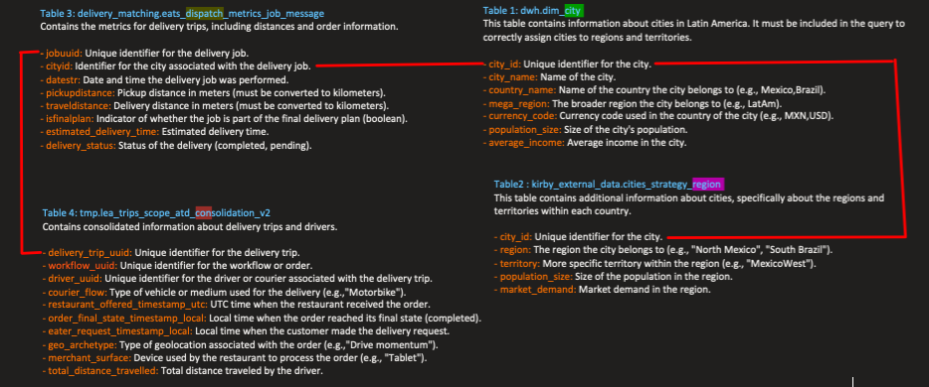
Objective: Data Preparation
Data Final Structure
territory: A subdivision within a region that denotes a more specific zone, such as a territorial division or operational area.
country_name: The name of the country where the delivery or service is being performed, represented by its common name
workflow_uuid: A unique global identifier (UUID) assigned to a specific workflow, used to track an order or process within the system.
driver_uuid: A unique global identifier (UUID) assigned to the driver or courier responsible for completing the delivery or task related to the workflow.
delivery_trip_uuid: A unique global identifier (UUID) associated with a specific delivery trip within a workflow.
courier_flow:The type of transport used by the courier to complete the delivery, such as "Motorbike", "Car", etc.
restaurant_offered_timestamp_utc: The date and time in UTC when the restaurant received the order and began processing it.
order_final_state_timestamp_local: The local date and time when the order reached its final state, for example, when the delivery was completed or the order reached its final status. eater_request_timestamp_local: The local date and time when the customer made the delivery request, i.e., when the order was created.
geo_archetype: The type of geolocation associated with the order, defined as a strategic region for marketing efforts.
merchant_surface: The type of device or interface used by the merchant (restaurant) to interact with the system, such as "Tablet", "Phone", etc.
pickup_distance: The distance in kilometers from the restaurant to the pickup point of the order.
dropoff_distance: The distance in kilometers from the pickup point to the final delivery destination, such as the customer's address.
ATD (Actual Time of Delivery): The total time, in minutes, it takes from when the order is rest offered (restaurant_offered_timestamp_utc)until it is delivered to the final destination (order_final_state_timestamp). This is a measure of the total delivery time, including both preparation and transit time.
Table | Description
dwh.dim_city | Information about cities in Latin America
kirby_external_data.cities_strategy_region | Information about cities, specifically about the regions and territories within each country.
delivery_matching.eats_dispatch_metrics_job_message | Mfor delivery trips, including distances and order information.
tmp.lea_trips_scope_atd_consolidation_v2 | Information about delivery trips and drivers.

Slide 5


Objective: Data Preparation
territory : Correction, replace ‘Long Tail - Region’ for ‘Long Tail’.
driver_uuid : 1.26% missing values, rename missing values as “Unknown”.
courier_flow: rename missing values as “Unknown”. Notice that “Motorbike”, “UberEats”, ‘Unknown’ and “Logistics” accumulate 98.6 %. The rest are dropped, their names do not sound like uber eats and their % is low.
geo_archetype: Notice that Drive momentum, Defend CP, Play offense accumulate 93.8 %, I can categorize the rest as others.
dropoff_distance & dropoff_distance = 1.28% missing values, the missing info in pickup_distance corresponds to the same rows as dropoff_distance, dropoff_distance,dropear since they only represent 1.28% are eliminated.
- geo_archetype: Between Drive momentum, Defend CP and Play offense accumulate 93%. - commercial_surface: Between POS, Tablet, Other accumulate 87.1%. - delivery_trip_uuid y workflow_uuid: It ensures that workflow_uuid and delivery_trip_uuid identifiers are unique by adding a sequential number in case of repetitions. This allows for accurate unique counts and avoids conflicts due to duplicate identifiers. After feature engineering, outliers were removed by interquartile range method.
Aprox:
800,000 per week
Aprox:
1,000,000 per week

Slide 6
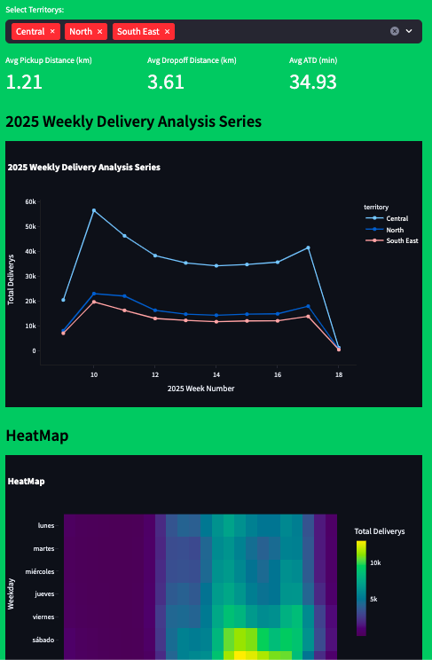
Intuitive, functional dashboard
Streamlit dashboard that showcases data analysis from the data received.
Github repository with easy instructions for easy reproduction
Territory filter available
Different intuitive vizualizations

Slide 7
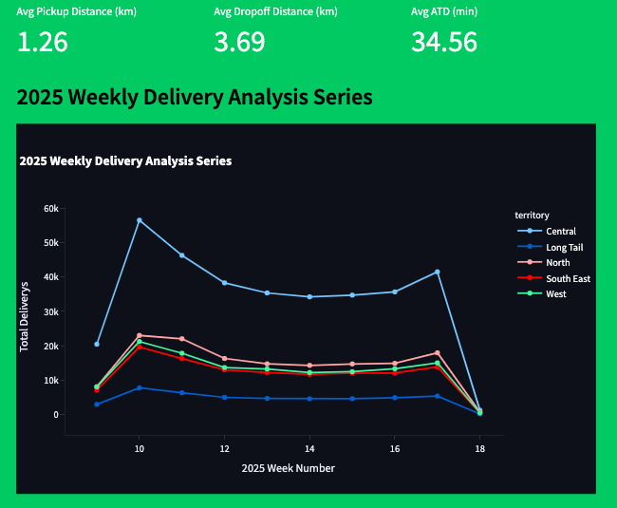
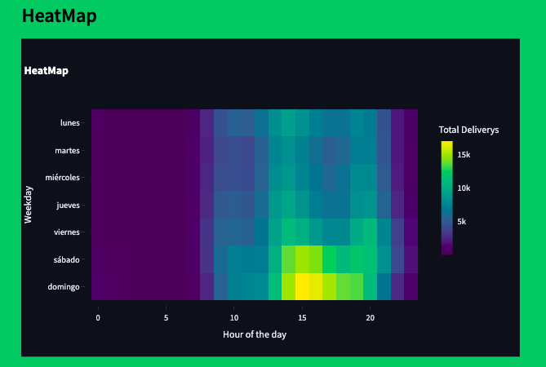
Insights
Mon
Tue
Wed
Thurs
Fri
Sat
Sun

Slide 8
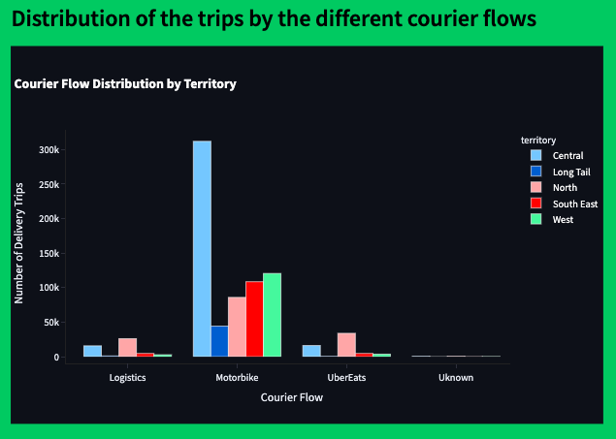
Insights

Slide 9
Prediction Models
Modelo | Description | R² Ajustado | MSE
MRL (Lasso Regularization) | Estimate a continuous variable trying to make the model as simple as possible, eliminating less important variables. | 0.157 | 161.5
Random Forest | Create many decision trees and average their results to avoid errors due to extreme or unstable decisions. | 0.241 | 145.4
HistGradientBoosting Regressor | It combines several small models (called trees) trained sequentially to improve the predictions bit by bit, using histograms to accelerate. | 0.259 | 141.8
Prior to training the Multiple Linear Regression model with Lasso regularization, the numerical variables were standardized using StandardScaler, taking them to mean 0 and standard deviation 1. The categorical variables were coded with One-Hot Encoding, omitting the first category to avoid multicollinearity. This transformation was only applied for this model; for the rest of the models (Random Forest, HistGradientBoosting, etc.), the variables were kept in their original scale.
To prevent data leakage, a division was made respecting the temporal order of the observations: 80% of the oldest data was used for training and the most recent 20% for testing, ensuring that the model did not access future information when trained.
The results obtained show limited performances (low R² and high errors), suggesting that there could be additional variables or interactions that better explain the variability of the target variable (ATD). It is recommended to continue exploring new variables and business characteristics that could provide greater predictive value.

Slide 10
Strategic implications and recommendations

